Slide 1


STORY TITLING USING NLP

Slide 2
Our Team:
Team Members:
19K41A0532 - Baluguri Anu
19K41A0447 - Maturi Nagasri

Slide 3
Agenda:
Introduction
Objectives
Beneficiaries
Dataset Insights
Deep Learning Model

Slide 4
Introduction:
Generating title for a story is a brainstorming process, which requires a lot of time.
Through this project, the crucial task becomes easy.
It takes the whole story as input and generates efficient and suitable title as output.

Slide 5
Objectives:
Identifying the central theme of the story and generating suitable title is our main objective.
Generating word embeddings for the story and story titles to train and test the model.
Building an efficient model, using LSTM
Training the model on dataset and acquiring good accuracy.

Slide 6
Beneficiaries:
1. Helpful to the editors of newspaper.
2.For writers to generate creative title.
3. Students as informative tool.

Slide 7
Dataset Insights:
Dataset consists of two columns : Story, Story Title
100 unique stories are present along with their corresponding story titles.
Examples :
Story : Once, there was a boy who became bored when he watched over the village sheep grazing on the hillside. To entertain himself, he sang out, “Wolf! Wolf! The wolf is chasing the sheep!”When the villagers heard the cry, they
Story Title : The Boy Who Cried Wolf

Slide 8
LITERATURE REVIEW
R.Jin (2002) describes a new probabilistic approach for title generation. He performs the probabilistic theories on text to extract the title. In very general terms they divide the process in two parts: finding the appropriate words and prepare a sequence. It is like a pragmatic analysis.
Paul E. Kennedy (2001) describes the non-extractive approach. The title can be generated without extracting the word from the document. In the model, the title and the document are considered as “the bag of words” Prepare a title vocabulary and a document vocabulary. Now, perform the estimation of probability of document word appear in the given document & title word appear in the corresponding title. This model consist the list of document word and tile word with assign the probabilities.

Slide 9
LITERATURE REVIEW (Cont.)
Cedric Lopez (2012) describes the survey on the titles. In title percentage of noun,percentage of adjective, percentage of adverb etc. In all kind of document, in 90% cases noun is the title. This is the highest percentage. In their system they provide the percentage of all categories. More is the noun candidate leads to the quality improvement of the title. This is implemented for French language.

Slide 10
PROPOSED METHODOLOGY
Natural Language Process is often used for textual segregation activities such as spam detection and emotional analysis, text production, language translation, and text classification.
BERT is used for word embeddings, in which word sequences are converted to numbered sequences.
The LSTM model contains an additional status (cell status) that allows the network to learn what it will store in the future, what to remove and what to read.

Slide 11
BERT :
BERT is used to generate contextualized embeddings.
It is trained by 2500 million words in Wikipedia and 800 million words in different books.
BERT is a stack of encoders. And it generates vector of size 768 as output.
BERT adds [CLS] and [SEP] at the beginning and end of the sentence.

Slide 12
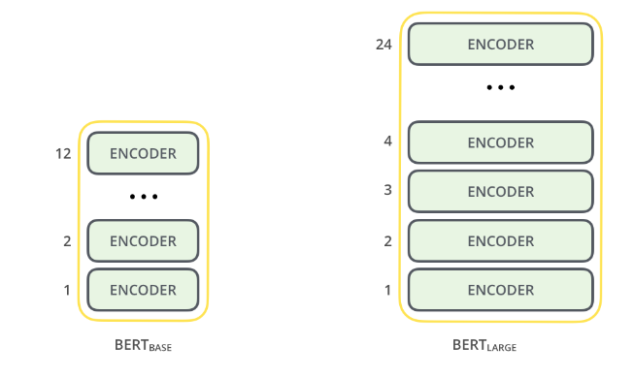
BERT Models:
BERT has two models : BERT BASE and BERT LARGE

Slide 13
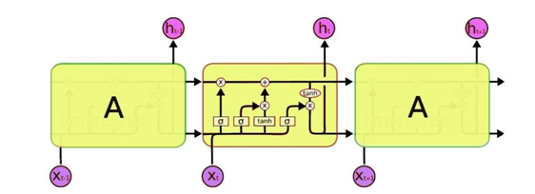
LSTM (Long Short Term Memory):
LSTM is a kind of Recurrent Neural Network which stores the long terms dependencies in the sentence.

Slide 14
DESIGN FLOW
Import Libraries
Read and Clean data
B
Embedding using
BERT
Testing and Deployment
Analysis of o/p
Create and train model

Slide 15
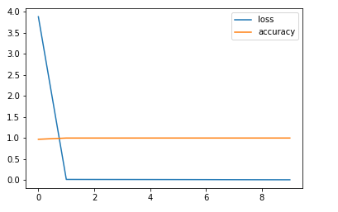
RESULTS
We trained our model using our dataset 80% of the dataset is used for training and 20% is used for testing. We used 15 epochs to train the data.

Slide 16


